Slide 1
Biobanks at UMC Utrecht:
Regulations and review practices

Slide 2
Biobank Regulations of UMC Utrecht
Responsible entity
Review of establishment of biobank
Biobank Research Ethics Committee (TCBio) and approval from Executive Board
Collection of clinical data and human biological material
departments
Processing
preferred partners, like CDL
Storage and catalogue
CBB
Review of release
TCBio or, subject to conditions, MREC for sub-biobanks
Physical release
CBB
chain

Slide 3
Biobank Regulations
Policy of UMC Utrecht
All collections of human biological material and data which fall within the scope of the sub-biobank definition

Slide 4
Biobank Regulations – Definitions
Sub-biobank:
A collection of human biological material and associated data for which the research question has not yet been formulated when they are obtained
A collection of human biological material and associated data left over after diagnostic procedures or treatment which are no longer needed for these purposes → residual material
Residual material from WMO research, review of release
Responsible sub-biobank coordinator: head of department
  Note: No time factor in definition of sub-biobank, so it applies also to ‘fresh’ residual material

Slide 5
Biobank Regulations – Scope
Sub-biobanks established under responsibility of UMC Utrecht
Patients or healthy volunteers asked to participate under responsibility of UMC Utrecht
Collaboration in which UMC Utrecht is involved
Biobank component of WMO studies in which UMC Utrecht is involved, including those with a commercial sponsor

Slide 6
Biobank Regulations – Donor’s right of say
Head of department is responsible for informing donor (but can delegate this).
Point of departure is broad consent. Donor can withdraw consent given at any time; this will only affect future research.
‘No objection’ arrangement is possible subject to conditions:
    It concerns residual material
    Donor can be reasonably assumed to have been informed
    Data used are fully anonymous or have been encoded
    There are no commercial purposes
    Human biological material is not being amplified to create immortal (stem) cells or cell lines

Slide 7
Biobank Regulations – TCBio (1)
Approach
Falls directly under Executive Board (not MREC chamber; composition and working methods similar to MREC)
Own Rules of Procedure
Advises Executive Board on establishment of sub-biobanks. After positive recommendation, Executive Board approval is needed before start.
- Template for biobank protocol
- Templates for biobank information letter, consent form, withdrawal form
Can approve release independently
Release protocol form
Committee is central point of contact for reporting of findings

Slide 8
Biobank Regulations – TCBio (2)
Criteria for establishment of sub-biobank
  Collection of human biological material with minimal risks
  Only possible if burden of collection is proportional to purpose of research
  Sufficient substantiation of collection of material in question for scientific purposes
  Accessible and comprehensible information for donor
  Human biological material and data stored and encoded in accordance with General Data Protection Regulation (GDPR)
Release criteria:
  Applicant is UMC Utrecht investigator
  Responsible sub-biobank coordinator approves
  Research will result in new scientific insights
  Use of material and traceable personal data is necessary
  Material use is proportional to interest of research
  Use does not violate donor’s right of say

Slide 9
Biobank Regulations – Transitional arrangements
Applies to sub-biobanks established after effective date of Biobank Regulations (Executive Board resolution of 25 June 2013)
Acquiring sub-biobanks must submit biobank protocol to TCBio within 1 year
Sub-biobanks must be included in the catalogue within 1 year
Human biological material must be submitted to CBB within 3 years

Slide 10
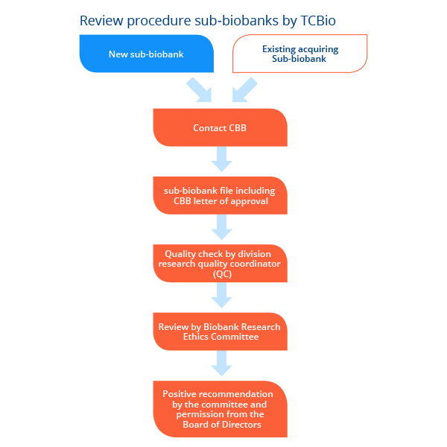

Slide 11
Review of release from sub-biobanks: in practice
Release requested via release protocol
Relevant versions of original biobank information letter and consent form enclosed (except for ‘no objection’ material)
If applicable: Material Transfer Agreement (MTA) – template via Department of Legal/Administrative Affairs (JBZ)
Quality check by division
Submission to TCBio
Review based on criteria referred to in Article 10
TCBio: approval for release

Slide 12
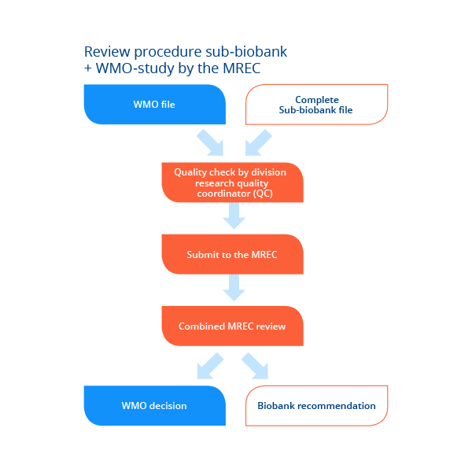

Slide 13
Review of file for sub-biobank combined with WMO study: in practice
Applicant’s choice: separate protocol & information letter or combine documents
Basic principle: it must be possible for MREC to review sub-biobank component separately under Biobank Regulations
List of ‘items to be reviewed’: TCBio website

Slide 14
Residual material from WMO study
Definition: Human biological material which has not been used, or not in full, for the WMO study for which it was obtained
WMO subjects:
  a) PIF/IC: ask for consent for storage of residual material from WMO study; state future research area in general terms;
  b) PIF: section on review of future research by TCBio
Applies regardless of storage location, such as
CBB / department / external sponsor / commercial organisation
Prior to further use: review of release by TCBio in accordance with Article 10 of the Biobank Regulations

Slide 15
Amendments in case of existing biobanks
Biobank establishment reviewed by MREC ‘as if under WMO’: positive recommendation
Amendments submitted to TCBio

Slide 16
Information on TCBio
More information: https://tcbio.umcutrecht.nl
Form templates
Submission instructions: digital
Meeting dates and submission dates
How to contact:
  T: 56376: Monday to Thursday
  E: TCBio@umcutrecht.nl

